Slide 1
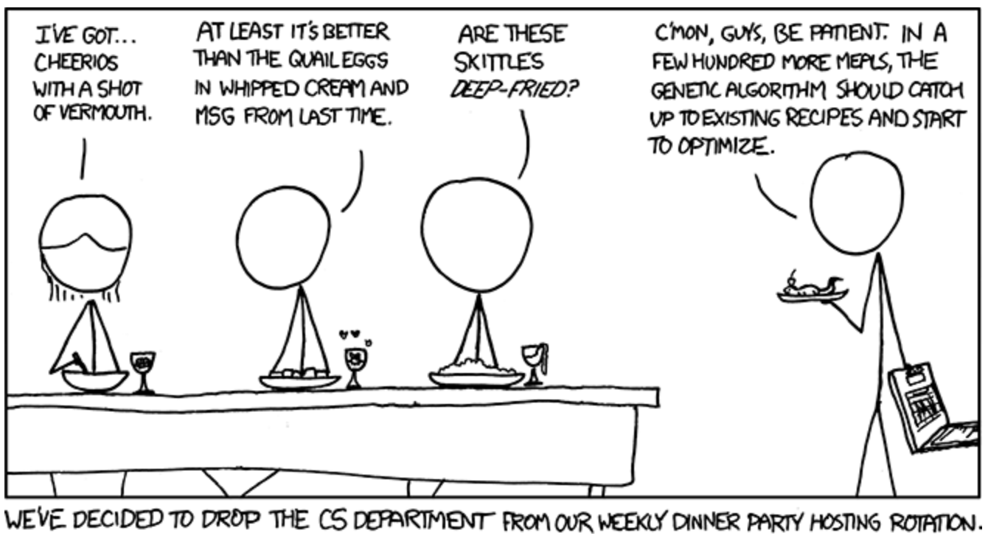
Exploration of Optimization Tools
https://xkcd.com/720/

Slide 2
Background
Optimization is an important tool in making decisions and in analyzing physical systems. In mathematical terms, an optimization problem is the problem of finding the best solution (i.e., maxima or minima) from among the set of all feasible solutions.
Bayesian optimization provides a probabilistically principled method to optimize objective functions that are often non-convex, non-linear, noisy and computationally expensive.
The Optimistic Optimizers plan to explore and test a variety of optimizing tools with many different objective functions to provide a guide for users to identify the best optimizing tool for their specific optimization needs.
Additional Features to be determined
Computational Expense
Optimizing Tool | Documentation | Ease of Use | Convergence Speed
Bayes_Opt
Optuna
…………
Additional Optimizing Tools to be added
…………
BayesO

Slide 3
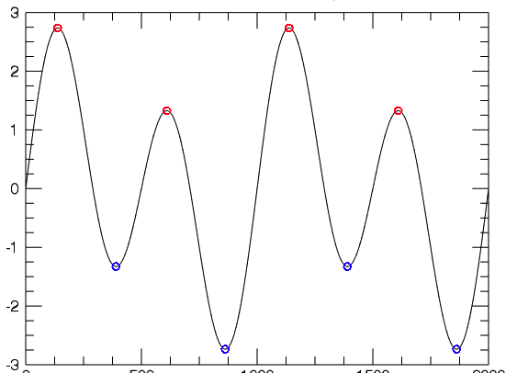
To optimize functions that have multiple local minima/maxima using less computational time

Slide 4
Technologies Considered
Technology | Description | Drawback
GPyOpt https://github.com/SheffieldML/GPyOpt | Bayesian optimization framework, written in Python and supporting parallel optimization, mixed factor types (continuous, discrete, and categorical), and inequality constraints. | Lacked adequate documentation Developers not longer very active in updating the package.
MOE https://github.com/Yelp/MOE | Supports parallel optimization via multi-point stochastic gradient ascent. Interfaces are provided for Python and C++, and optimization can be accelerated on GPU hardware. | Last update to the package was over 7 years ago
PuLP https://github.com/coin-or/pulp | PuLP is an LP modeler written in Python to solve linear problems. | Documentation difficult to follow Applications seem more limited than other packages explored
Sources:
https://ieeexplore.ieee.org/stamp/stamp.jsp?arnumber=8957442
https://towardsdatascience.com/linear-programming-and-discrete-optimization-with-python-using-pulp-449f3c5f6e99

Slide 5
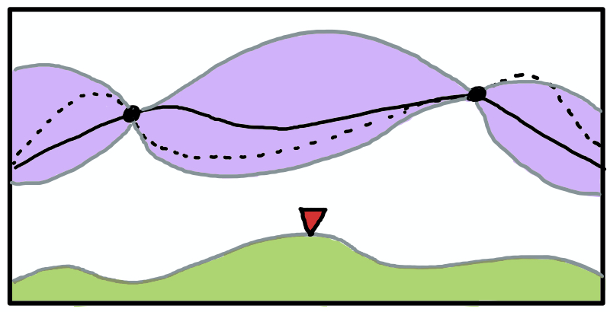
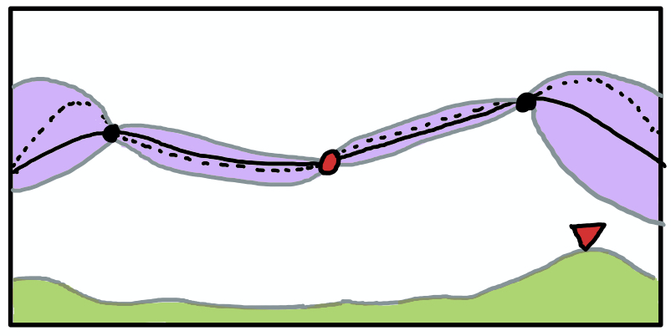
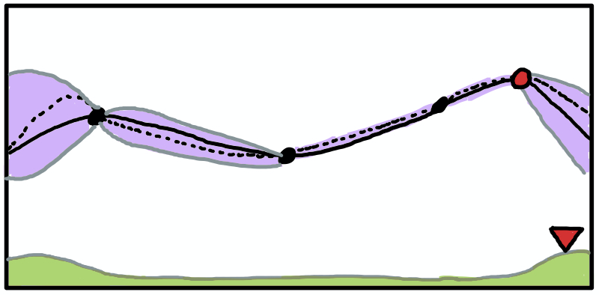


“Bayes_Opt” Bayesian Optimization
Posterior mean
True objective
Acquisition Max
This is a constrained global optimization package built upon Bayesian inference and Gaussian process.
Constrained global optimization - process of optimizing an objective function with respect to some variables in the presence of constraints on those variables
It attempts to find the maximum or minimum value of a function in as few iterations as possible.
This is particularly useful for optimization of high-cost functions or situations where the balance between exploration and exploitation is important.
Example: Drilling for oil, testing each location may cost $1 million or more
Since this is a constrained optimization technique, so you must specify the bounds for each parameter for it to work
Posterior mean +/- std dev
Acquisition function

Slide 6
Optuna
Random Search
Samples random points and return the optimum value
Tree-structured Parzen Estimator
Creates a cost function to be minimized
Samples objective function and models the data using Parzen Estimators (KDE)
Draws new samples based on the greatest expected improvement
Covariance Matrix Adaptation Evolution Strategy (CMA-ES)
Sample new solutions
Rank solutions based on their score
Update guess (Covariance Matrix and Multivariate Gaussian Distribution)

Slide 7
Drawbacks
Results are sensitive to hyper parameters which underestimates uncertainty
The objective is a complex function which is expensive and timely to evaluate
The outcome are not the exact optimum (not accurate)

Slide 8
Next Steps (here we can talk about how we plan on finding additional optimizers to explore and creating a variety of functions to test out with the optimizers ??)
Look at the optimizers we have and run the different packages for the sake of simpilicity will choose a simple function to try all the packages on this function and see what will be the results in terms of time, complexity as well as the optimal answer that wegaps we have to fill
Find the optimizers that fill those gaps that give the user the option to choose from
Test the optimizers with one known function

Slide 9

Questions?

